Slide 1
Multi GPU Programming with MPI and OpenACC
25.10.2018| J. Kraus (NVIDIA)

Slide 2
MPI+OpenACC
Node 0
Node 1
Node N-1
MEM
MEM
MEM
MEM
MEM
MEM
MEM
MEM
MEM
MEM
MEM
MEM
GPU
CPU
GPU
CPU
GPU
CPU
…
PCIe
Switch
PCIe
Switch
PCIe
Switch
IB
IB
IB

Slide 3
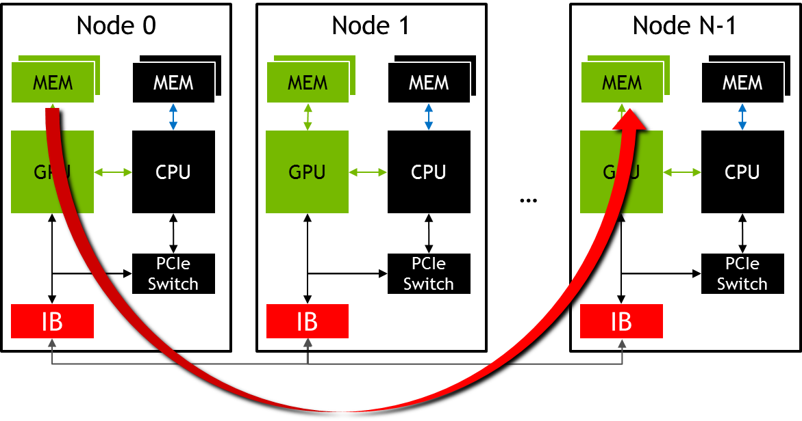
MPI+OpenACC
//MPI rank 0
#pragma acc host_data use_device( sbuf )
MPI_Send(sbuf, size, MPI_DOUBLE, n-1, tag, MPI_COMM_WORLD);
//MPI rank n-1
#pragma acc host_data use_device( rbuf )
MPI_Recv(rbuf, size, MPI_DOUBLE, 0, tag, MPI_COMM_WORLD, MPI_STATUS_IGNORE);

Slide 4
What you will learn
What MPI is
How to use MPI for inter GPU communication with OpenACC
How to use pgprof for MPI+OpenACC applications
How to hide MPI communication times

Slide 5
Message Passing Interface - MPI
Standard to exchange data between processes via messages
Defines API to exchanges messages
Pt. 2 Pt.: e.g. MPI_Send, MPI_Recv
Collectives, e.g. MPI_Allreduce
Multiple implementations (open source and commercial)
Binding for C/C++, Fortran, Python, …
E.g. MPICH, OpenMPI, MVAPICH, IBM Platform MPI, Cray MPT, …

Slide 6

MPI – A minimal program
#include <mpi.h>
int main(int argc, char *argv[]) {
int rank,size;
/* Initialize the MPI library */
MPI_Init(&argc,&argv);
/* Determine the calling rank and total number of ranks */
MPI_Comm_rank(MPI_COMM_WORLD,&rank);
MPI_Comm_size(MPI_COMM_WORLD,&size);
/* Call MPI routines like MPI_Send, MPI_Recv, ... */
...
/* Shutdown MPI library */
MPI_Finalize();
return 0;
}
Remark: Almost all MPI routines return an error value which should be checked. The examples and tasks leave that out for brevity.

Slide 7
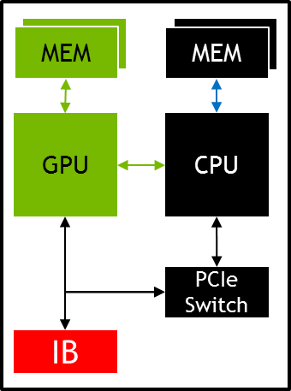
MPI – Compiling and Launching
$ mpicc -o myapp myapp.c
$ srun -n 4 ./myapp <args>
rank = 0
rank = 1
rank = 2
rank = 3
myapp
myapp
myapp
myapp

Slide 8
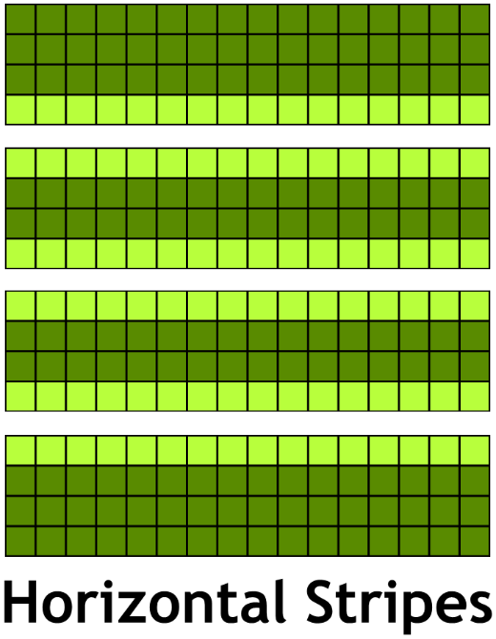
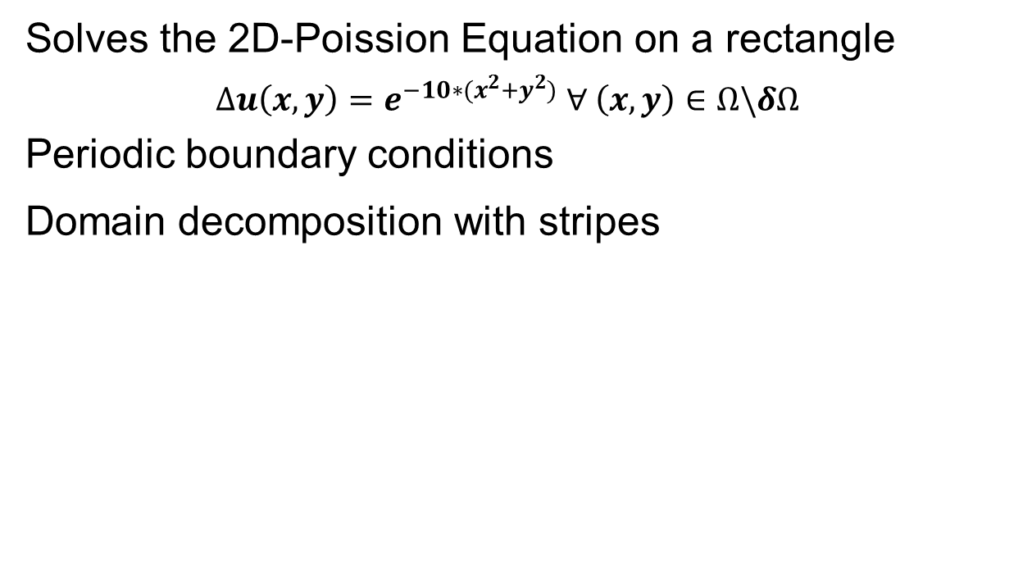
Example: Jacobi Solver
Solves the 2D-Poission Equation on a rectangle
$$∆u\left(x,y\right)=e^{−10∗(x^{2}+y^{2})} ∀ \left(x,y\right)∈Ω\backslash δΩ$$
Periodic boundary conditions
Domain decomposition with stripes

Slide 9
Example: Jacobi Solver – Single GPU
While not converged
Do Jacobi step:
for (int iy = 1; iy < ny-1; ++iy)
for (int ix = 1; ix < nx-1; ++ix)
Anew[iy*nx+ix]=-0.25f*(rhs[iy*nx+ix]
-(A[iy*nx+(ix-1)]+A[iy*nx+(ix+1)]
+A[(iy-1)*nx+ix]+A[(iy+1)*nx+ix]));
Copy Anew to A
Apply periodic boundary conditions
Next iteration

Slide 10
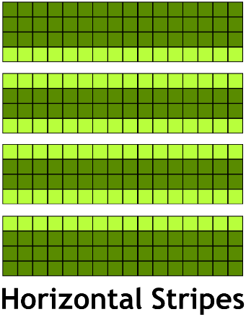
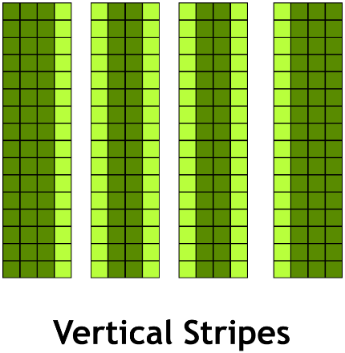
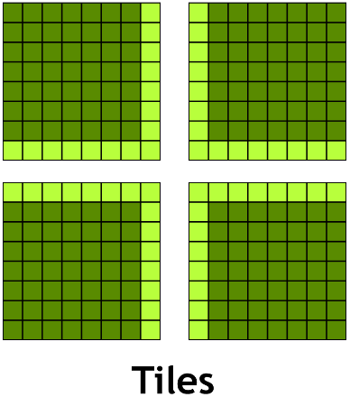
Domain Decomposition
Different ways to split the work between processes:
Minimizes number of neighbors:
Communicate to less neighbors
Optimal for latency bound communication
Minimizes surface area/volume ratio:
Communicate less data
Optimal for bandwidth bound communication
Contiguous if data is row-major
Contiguous if data is column-major

Slide 11
Example: Jacobi Solver – Multi GPU
While not converged
Do Jacobi step:
for (int iy = iy_start; iy < iy_end; ++iy)
for (int ix = 1; ix < NX-1; ++ix)
Anew[iy*nx+ix]=-0.25f*(rhs[iy*nx+ix]
-(A[iy*nx+(ix-1)]+A[iy*nx+(ix+1)]
+A[(iy-1)*nx+ix]+A[(iy+1)*nx+ix]));
Copy Anew to A
Apply periodic boundary conditions and exchange halo with 2 neighbors
Next iteration

Slide 12
Example: Jacobi – Top/Bottom Halo
#pragma acc host_data use_device ( A ) {
MPI_Sendrecv(A+iy_start*nx+1, nx-2, MPI_DOUBLE, top, 0,
A+iy_end*nx+1, nx-2, MPI_DOUBLE, bottom, 0,
MPI_COMM_WORLD, MPI_STATUS_IGNORE);
2
1
MPI_Sendrecv(A+(iy_end-1)*nx+1, nx-2, MPI_DOUBLE, bottom, 1,
A+(iy_start-1)*nx+1, nx-2, MPI_DOUBLE, top, 1,
MPI_COMM_WORLD, MPI_STATUS_IGNORE);
}
2
1

Slide 13
Handling GPU Affinity
Rely on process placement (with on rank per GPU)*
#if _OPENACC
acc_device_t device_type = acc_get_device_type();
int ngpus=acc_get_num_devices(device_type);
int devicenum=rank%ngpus;
#endif /*_OPENACC*/
#pragma acc set device_num( devicenum )
#if _OPENACC // Or using the API:
acc_set_device_num(devicenum,device_type);
#endif /*_OPENACC*/
* This assumes the node is homogeneous, i.e. that all the GPUs are the same. If you have different GPUs in the same node then you may need some more complex GPU selection
Alternative (JURECA):
int devicenum = atoi(getenv("MPI_LOCALRANKID"));

Slide 14
Profiling MPI+OPENACC applications
Embed MPI rank in output filename, process name, and context name
srun pgprof --cpu-profiling off
--output-profile profile.%q{PMI_RANK} \
--process-name "rank %q{PMI_RANK}“ \
--context-name "rank %q{PMI_RANK}"
JURECA: PMI_RANK
OpenMPI: OMPI_COMM_WORLD_RANK
MVAPICH2: MV2_COMM_WORLD_RANK
Notes:
--cpu-profiling off is necessary due to an issue with MVAPICH2

Slide 15
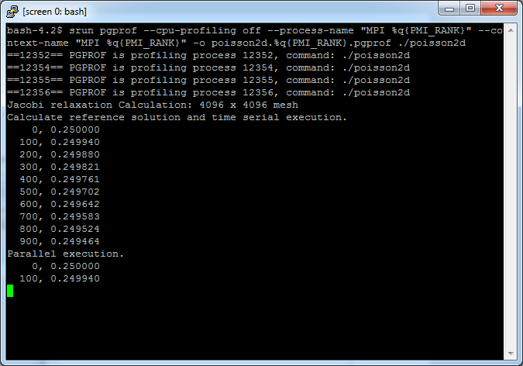
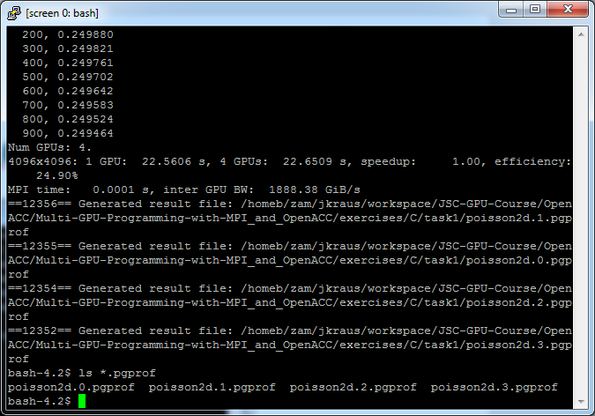
Profiling MPI+OpenACC applications

Slide 16
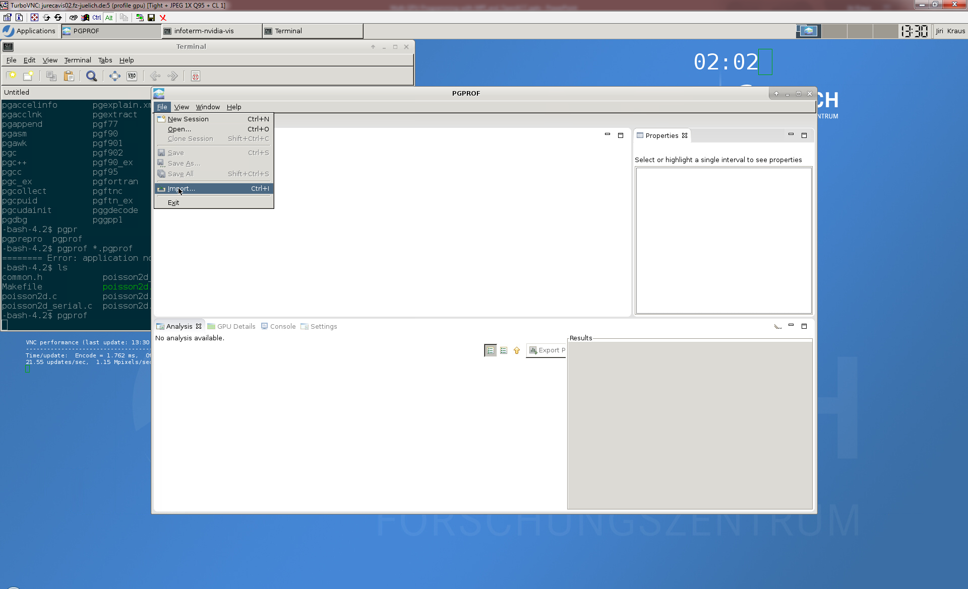
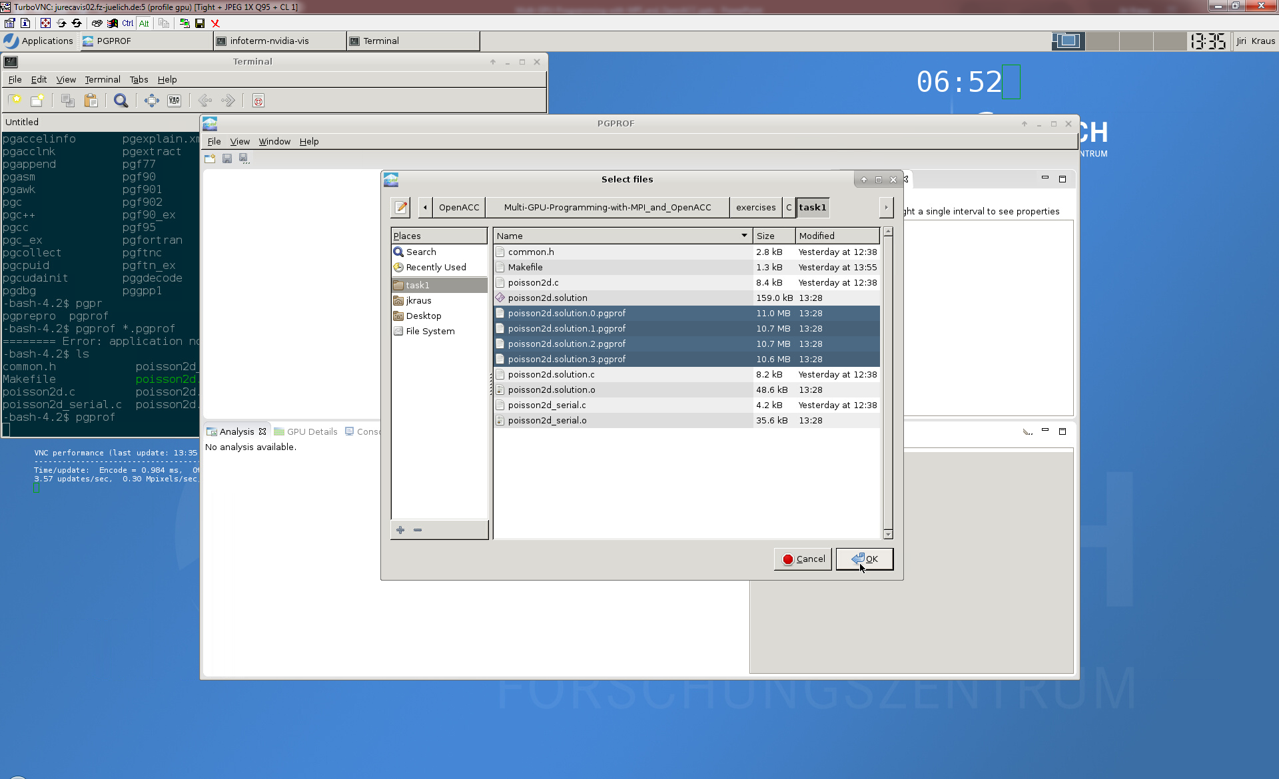
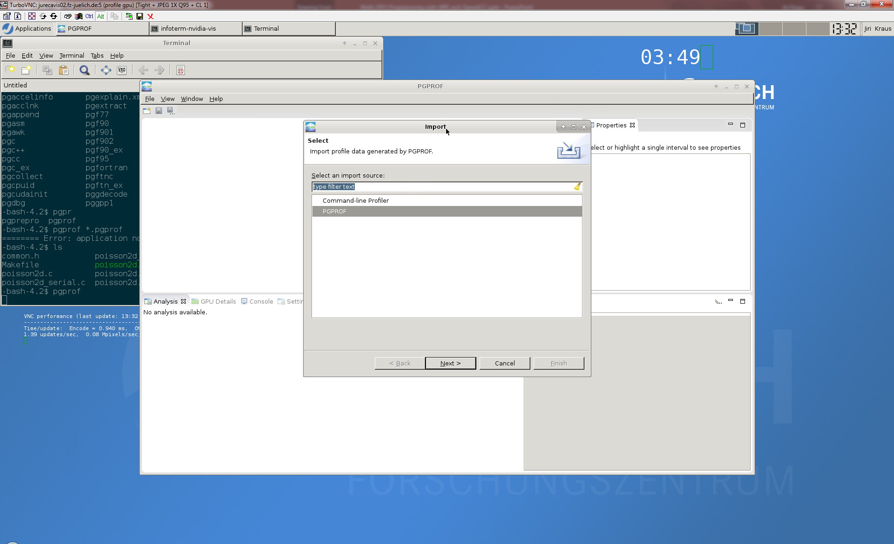

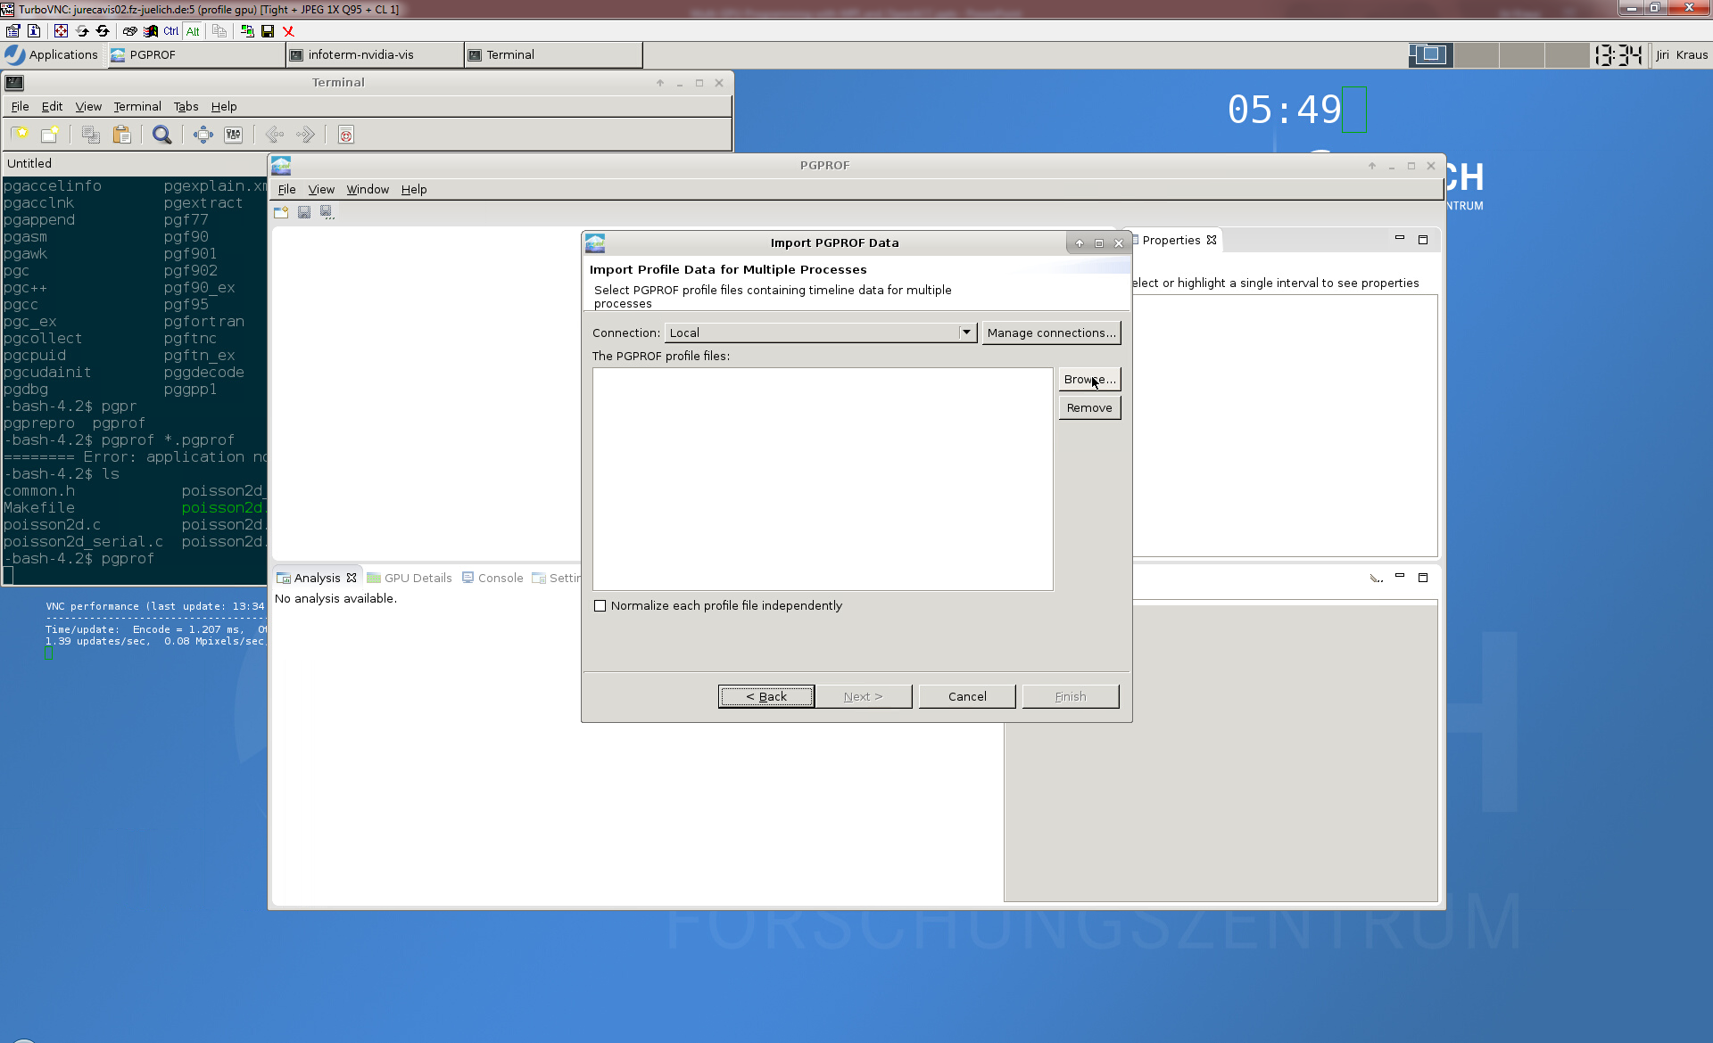

Profiling MPI+OpenACC applications

Slide 17
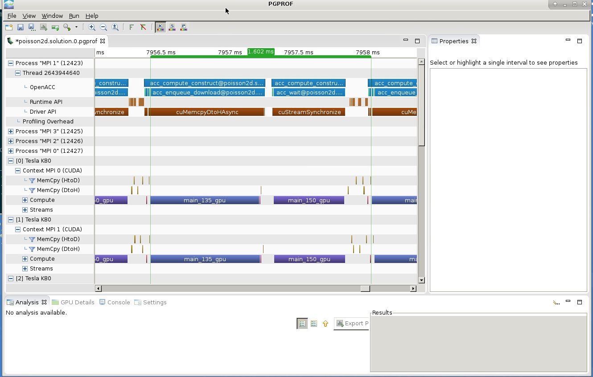
Profiling MPI+OpenACC applications

Slide 18
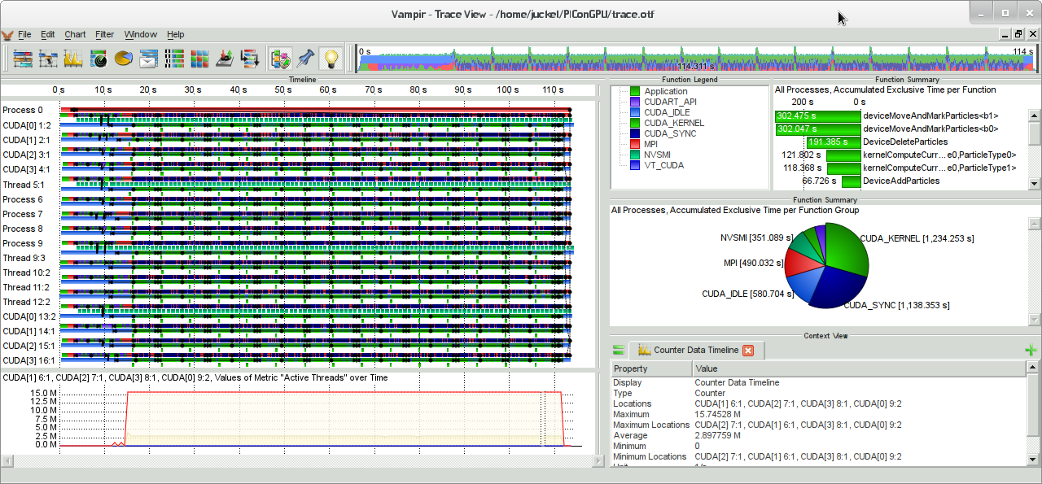
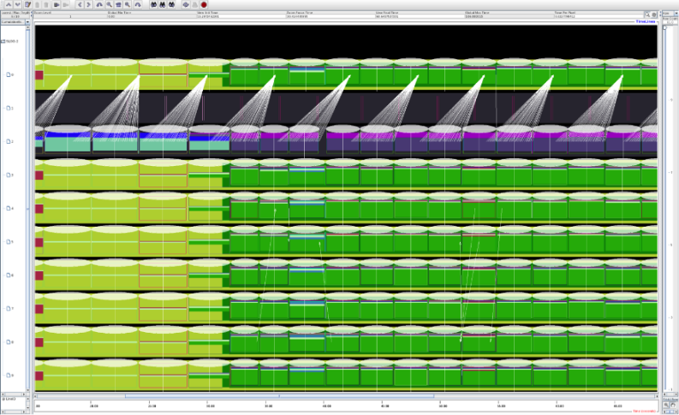
Profiling MPI+OpenACC applications
Multiple parallel profiling tools are CUDA-aware
Score-P
Vampir
Tau
These tools are good for discovering MPI issues as well as basic CUDA performance inhibitors.

Slide 19
Communication + Computation Overlap

Slide 20
Communication + Computation Overlap
No Overlapp
Process whole domain
MPI
Boundary and inner domain processing can overlapp
Overlapp
Process inner domain
Possible Speedup
Process boundary domain
MPI
Dependency

Slide 21
Communication + Computation Overlap
#pragma acc parallel loop
for ( ... )
//Process boundary
#pragma acc parallel loop async
for ( ... )
//Process inner domain
#pragma acc host_data use_device ( A )
{
//Exchange halo with top and bottom neighbor
MPI_Sendrecv( A…);
//…
}
//wait for iteration to finish
#pragma acc wait

Slide 22
Scalability Metrics For Success
Serial Time: 𝑇𝑠:
How long it takes to run the problem with a single process
Parallel Time: 𝑇𝑝
How long it takes to run the problem with multiple processes
Number of Processes: 𝑃
The number of Processes operating on the task at hand
Speedup: 𝑆=𝑇𝑠/𝑇𝑝
How much faster is the parallel version vs. serial. (optimal is 𝑃)
Efficiency: 𝐸= 𝑆/𝑃
How efficient are the processors used (optimal is 1)

Slide 23
Task 1: Apply domain decomposition
Look for TODOs
Handle GPU affinity
Halo Exchange
$ make
mpicc -c -DUSE_DOUBLE -Minfo=accel -fast -acc -ta=tesla poiss [...]
srun ./poisson2d
Jacobi relaxation Calculation: 4096 x 4096 mesh
[...]
Num GPUs: 4.
4096x4096: 1 GPU: 18.9390 s, 4 GPUs: 18.8453 s, speedup:
MPI time: 0.0001 s, inter GPU BW: 1770.76 GiB/s
Make Targets:
run: run poisson2d (default)
poisson2d: build poisson2d binary
profile: profile with pgprof
*.solution: same as above with solution
(poisson2d.solution.*)

Slide 24
Task 2: Hide MPI communication time
Look for TODOs
Start copy loop asynchronously
Wait for async copy loop after MPI comm. is done
$ make
mpicc -c -DUSE_DOUBLE -Minfo=accel -fast -acc -ta=tesla poisso [...]
srun ./poisson2d
Jacobi relaxation Calculation: 4096 x 4096 mesh
[...]
Num GPUs: 4.
4096x4096: 1 GPU: 4.6780 s, 4 GPUs: 1.3290 s, speedup:
MPI time: 0.0846 s, inter GPU BW: 1.44 GiB/s
Make Targets:
run: run poisson2d (default)
poisson2d: build poisson2d binary
profile: profile with pgprof
*.solution: same as above with solution
(poisson2d.solution.*)

Slide 25
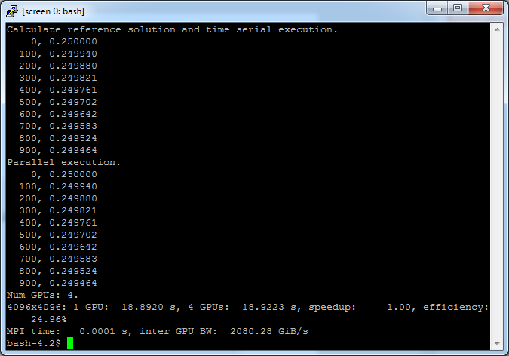
Task 1: Initial Version

Slide 26
Task 1: Solution
//Initialize MPI and determine rank and size
MPI_Init(&argc, &argv);
MPI_Comm_rank(MPI_COMM_WORLD, &rank);
MPI_Comm_size(MPI_COMM_WORLD, &size);
#pragma acc set device_num( rank )
real* restrict const A = (real*) malloc(nx*ny*sizeof(real));
real* restrict const Aref = (real*) malloc(nx*ny*sizeof(real));
real* restrict const Anew = (real*) malloc(nx*ny*sizeof(real));
real* restrict const rhs = (real*) malloc(nx*ny*sizeof(real));

Slide 27
Task 1: Solution
// Ensure correctness if ny%size != 0
int chunk_size = ceil( (1.0*ny)/size );
int iy_start = rank * chunk_size;
int iy_end = iy_start + chunk_size;
// Do not process boundaries
iy_start = max( iy_start, 1 );
iy_end = min( iy_end, ny - 1 );

Slide 28
Task 1: Solution
int top = (rank == 0) ? (size-1) : rank-1;
int bottom = (rank == (size-1)) ? 0 : rank+1;
#pragma acc host_data use_device( A ) {
//1. Sent row iy_start (first modified row) to top receive lower boundary (iy_end)
//from bottom
MPI_Sendrecv( A+iy_start*nx+ix_start, (ix_end-ix_start), MPI_REAL_TYPE, top , 0,
A+iy_end*nx+ix_start, (ix_end-ix_start), MPI_REAL_TYPE, bottom, 0,
MPI_COMM_WORLD, MPI_STATUS_IGNORE );
//2. Sent row (iy_end-1) (last modified row) to bottom
//receive upper boundary (iy_start-1) from top
MPI_Sendrecv( A+(iy_end-1)*nx+ix_start, (ix_end-ix_start), MPI_REAL_TYPE, bottom, 0,
A+(iy_start-1)*nx+ix_start, (ix_end-ix_start), MPI_REAL_TYPE, top , 0,
MPI_COMM_WORLD, MPI_STATUS_IGNORE );
}

Slide 29
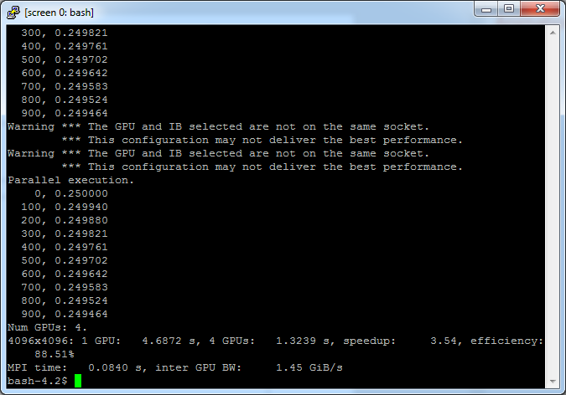
Task 1: Solution

Slide 30
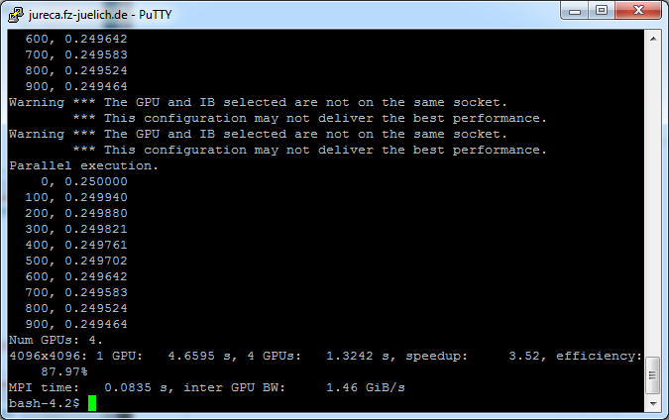
Task 2: Initial Version

Slide 31
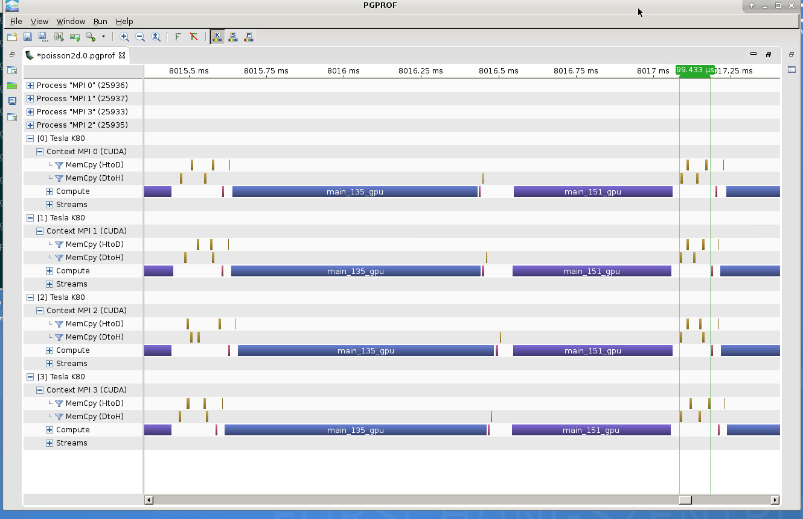
Task 2: Initial Version

Slide 32
Task 2: Solution
#pragma acc parallel loop present(A,Anew)
for( int ix = ix_start; ix < ix_end; ix++ ) {
A[(iy_start)*nx+ix] = Anew[(iy_start)*nx+ix];
A[(iy_end-1)*nx+ix] = Anew[(iy_end-1)*nx+ix];
}
#pragma acc parallel loop present(A,Anew) async
for (int iy = iy_start+1; iy < iy_end-1; iy++) {
for( int ix = ix_start; ix < ix_end; ix++ ) {
A[iy*nx+ix] = Anew[iy*nx+ix];
} }
int top = (rank == 0) ? (size-1) : rank-1;
int bottom = (rank == (size-1)) ? 0 : rank+1;
#pragma acc host_data use_device( A )
{
MPI_Sendrecv( A+iy_start*nx+ix_start, (ix_end-ix_start), MPI_REAL_TYPE, top , 0,
A+iy_end*nx+ix_start, (ix_end-ix_start), MPI_REAL_TYPE, bottom, 0,
MPI_COMM_WORLD, MPI_STATUS_IGNORE );
MPI_Sendrecv( A+(iy_end-1)*nx+ix_start, (ix_end-ix_start), MPI_REAL_TYPE, bottom, 0,
A+(iy_start-1)*nx+ix_start, (ix_end-ix_start), MPI_REAL_TYPE, top , 0,
MPI_COMM_WORLD, MPI_STATUS_IGNORE );
}
#pragma acc wait

Slide 33
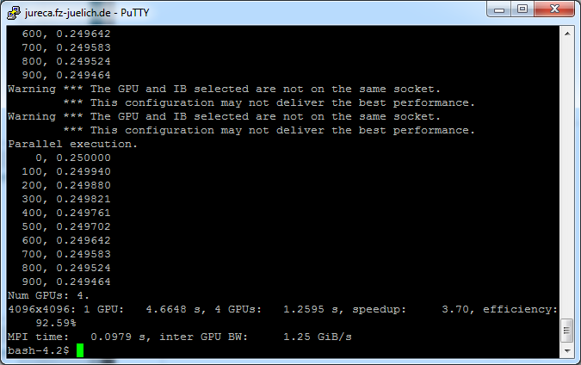
Task 2: Solution

Slide 34
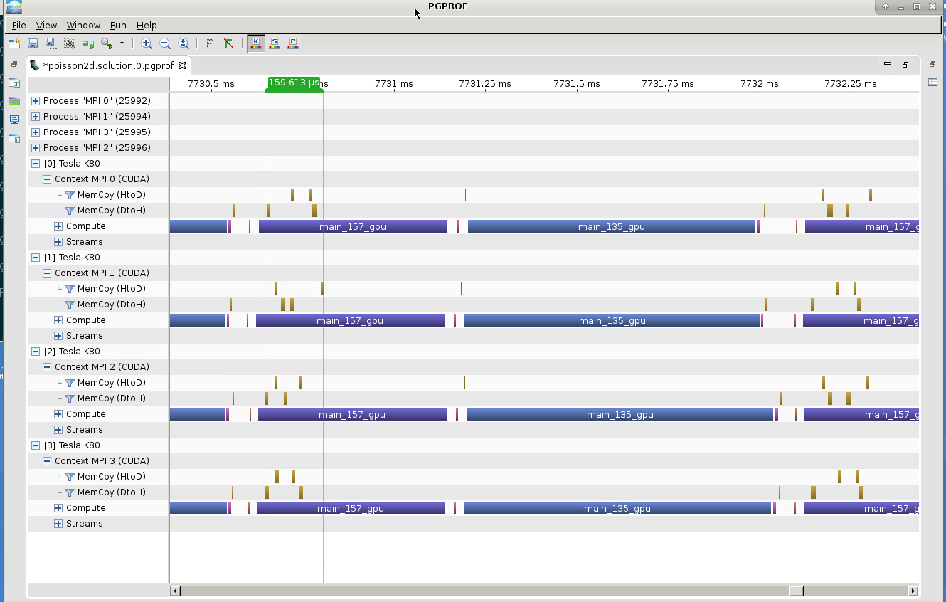
Task 2: Solution

Slide 35
Communication + Computation Overlap

Slide 36
Hands-on Setup Environment
$ module use /usr/local/software/jureca/OtherStages;
$ module load Stages/2017a
$ module load PGI MVAPICH2
$ export TMPDIR=${HOME}/tmp
$ mkdir -p $TMPDIR

